Slide 1

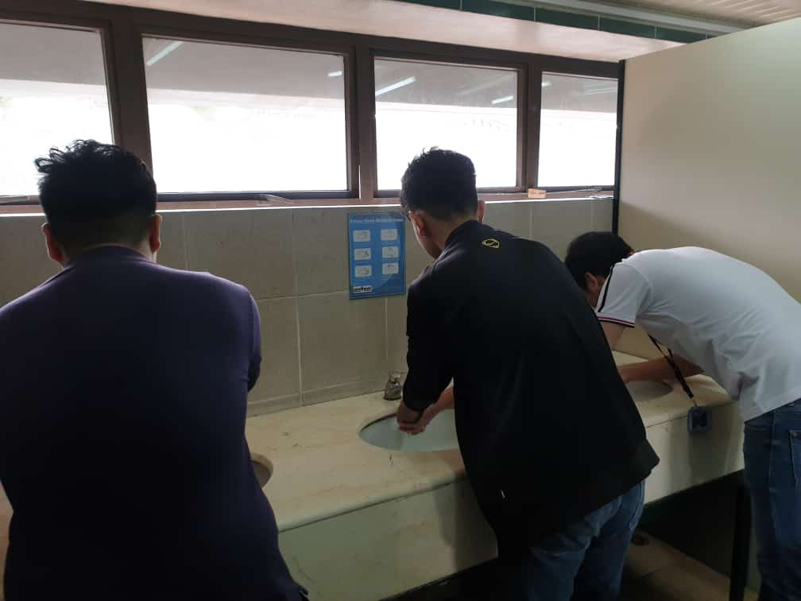
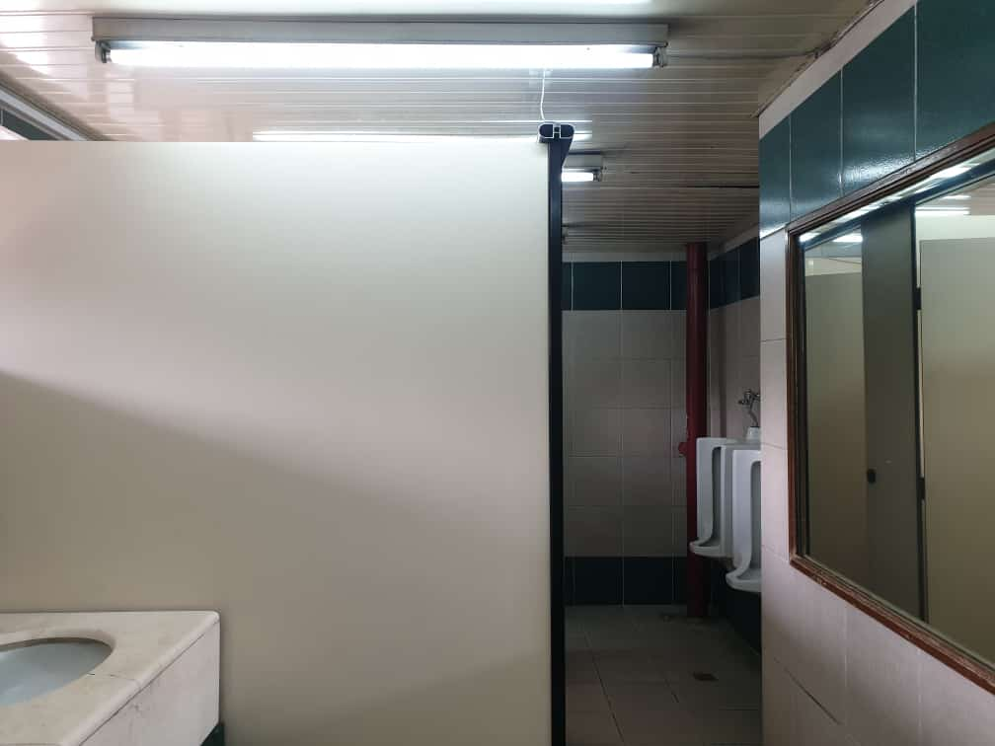
The Use of Restroom
Asia Pacific College
Needfinding
We examined it by observing the male restroom and by interviewing certain people.

Slide 2
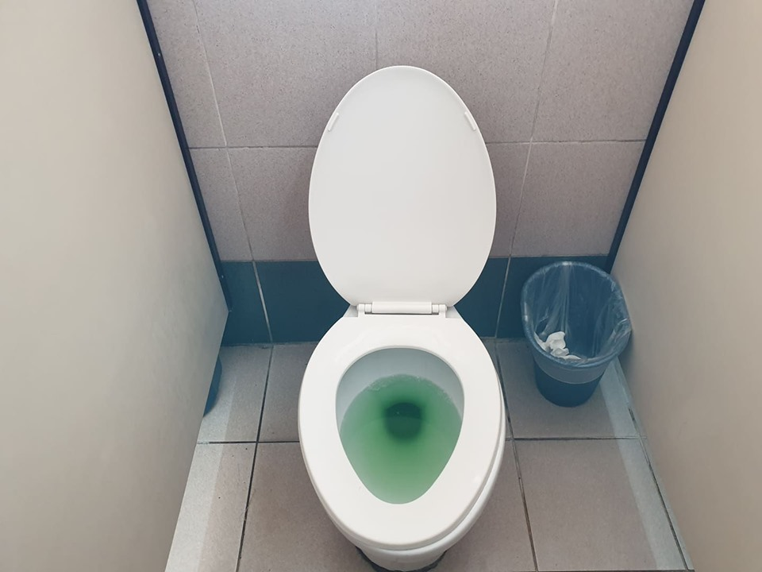
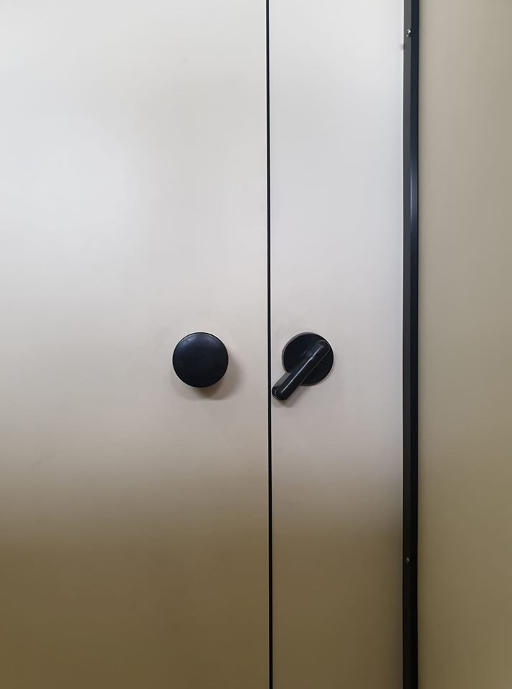
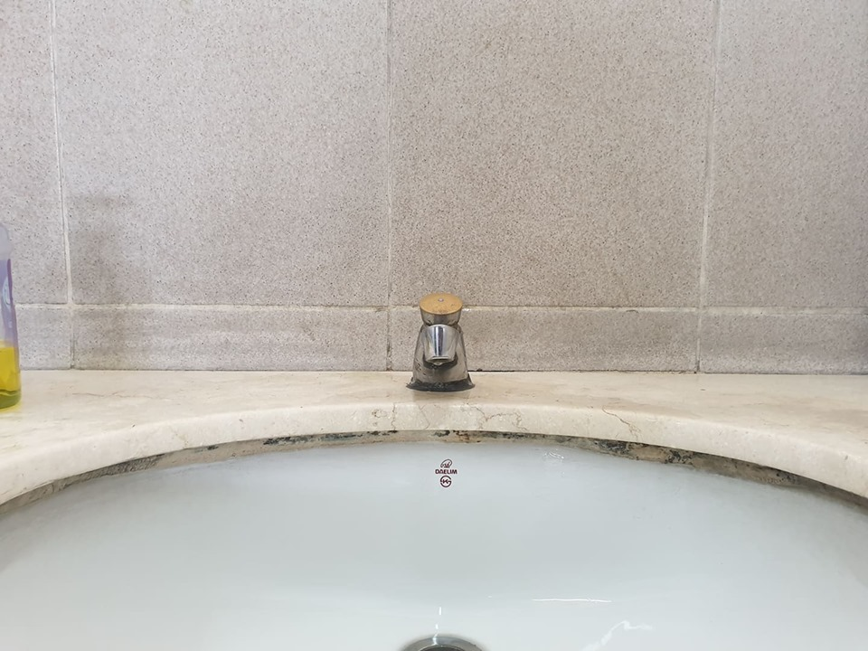
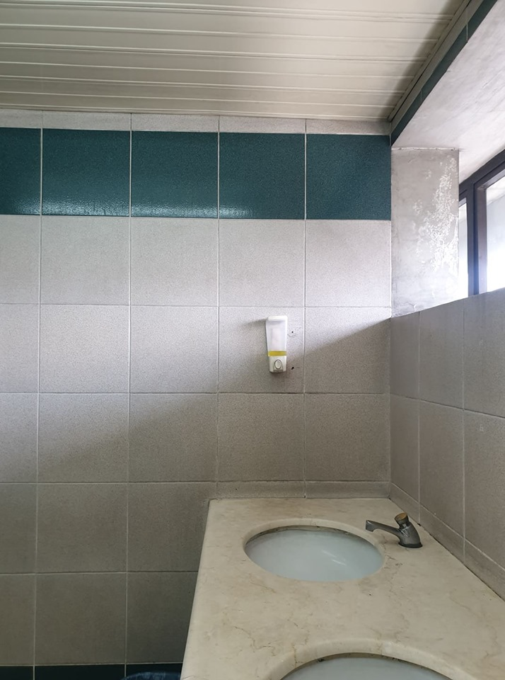
We examined it by observing the male restroom and by interviewing certain people.

Slide 3
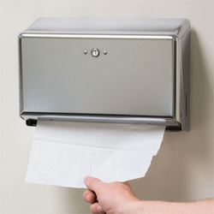
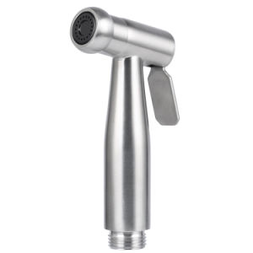
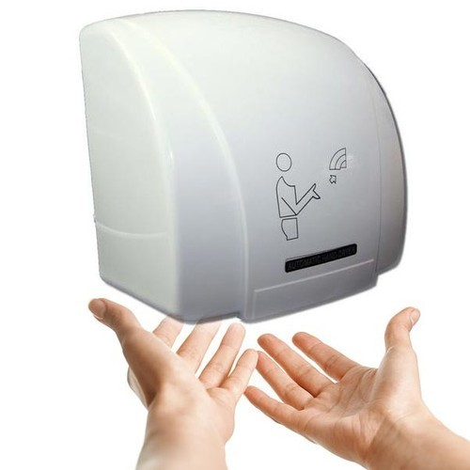

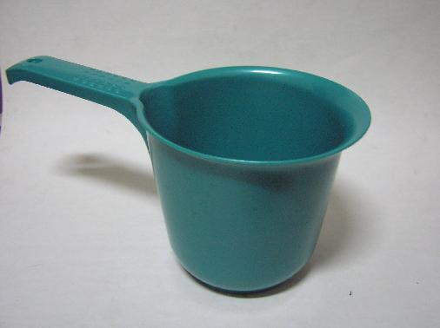
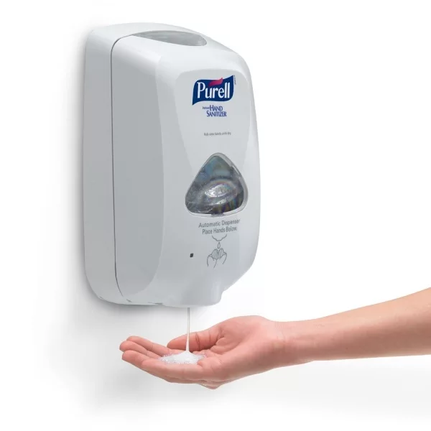
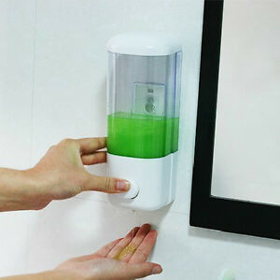
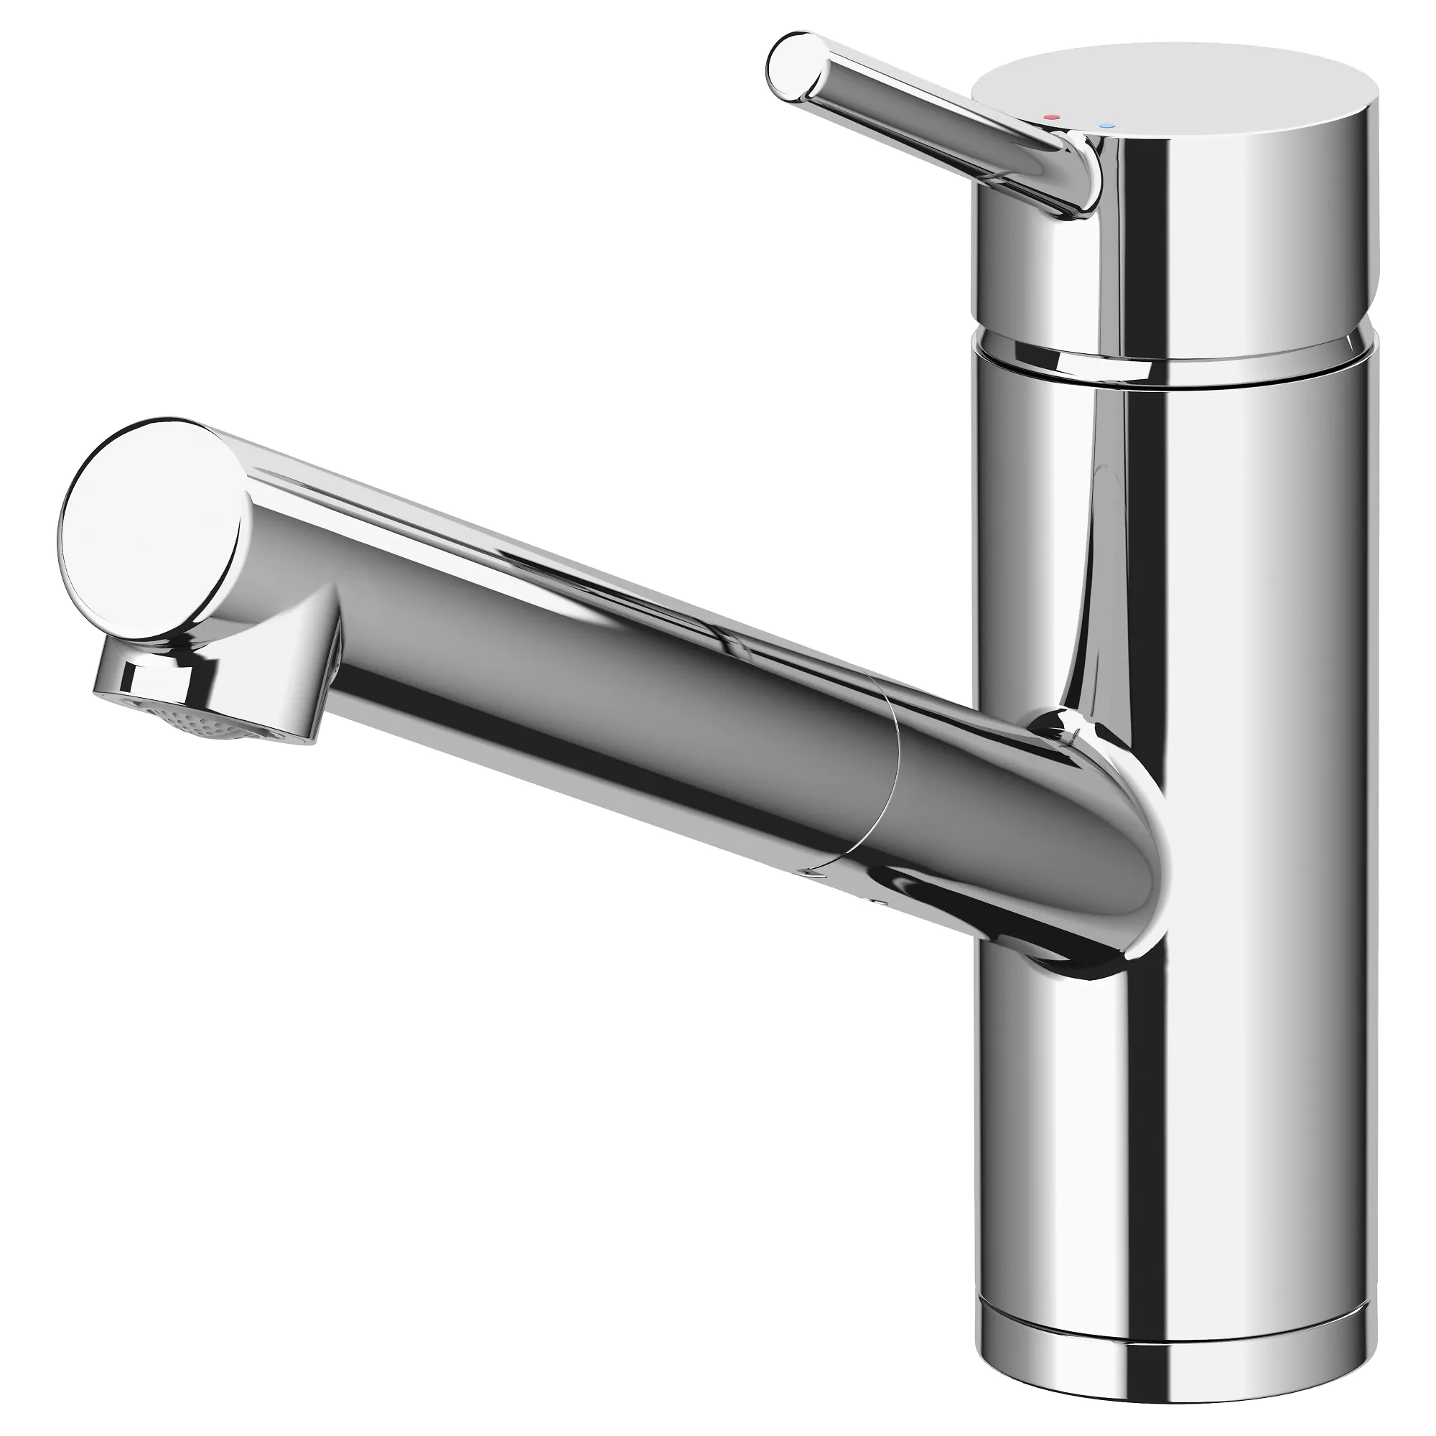

Major Insights or Breakdowns
Tissue
Bidet
Hand Dryer
Tabo
Hand sanitizer
Hand soap
Absence of Bidet
Defective Door Locks
Defective Faucets
Absence of Hand Dryer
Faucet
Tissue Vendo

Slide 4
Tissue
Bidet
Hand Dryer
Tabo
Hand sanitizer
Hand soap
Faucet
Tissue Vendo

